Slide 1


MODERN
NATURAL
LANGUAGE PROCESSING
MODERN
MODERN
Lara WEHBE - AI Engineer

Slide 2
OUTLINE
MODERN
Who’s your speaker?
AI Definition
Types of AI
History of AI
Why NLP?
NLP Fundamentals
NLP Applications
MODERN
MODERN

Slide 3
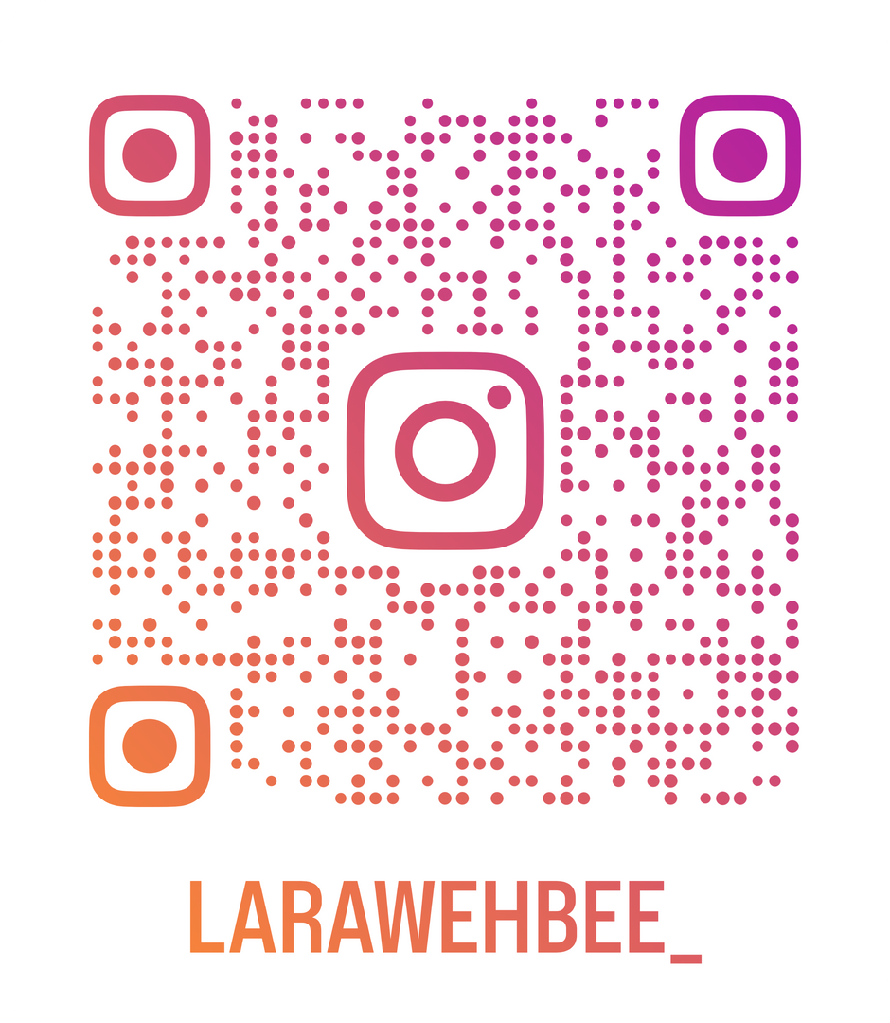
KNOW YOUR SPEAKER
BS.C Computer Science - LU
M1 in AI and Machine Learning - USJ
Currently Studying M2 in Machine Learning at LU
AI Engineer with 3+ years of experience

Slide 4
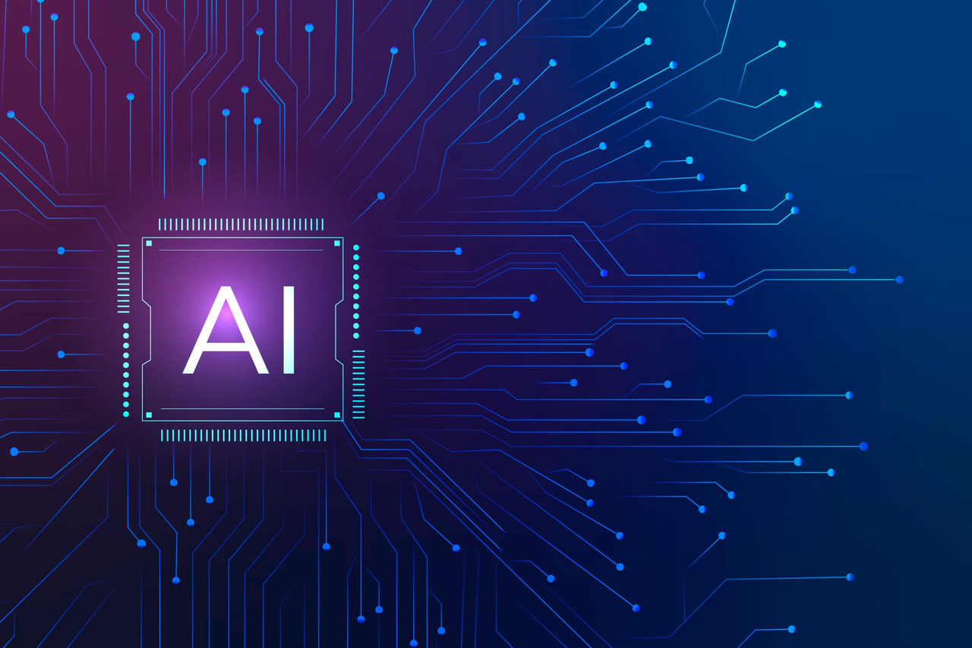
WHAT IS AI?
MODERN
MODERN
MODERN

Slide 5
WHAT IS AI?
MODERN
MODERN
AI is the ability of
Machines to mimic
the Human Behavior
MODERN

Slide 6
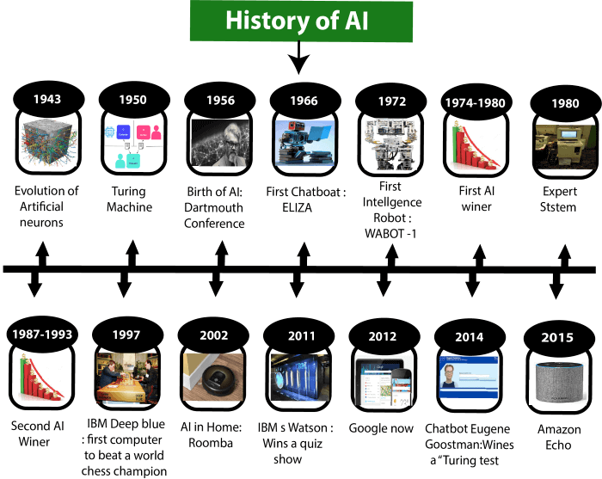
HOW IT ALL STARTED?

Slide 7




TYPES OF AI
NARROW AI
GENERAL AI
SUPER AI
Each AI Agent does only one thing
Each Agent can do more than one thing at a time!
Humans can now sleep for infinite years ..

Slide 8
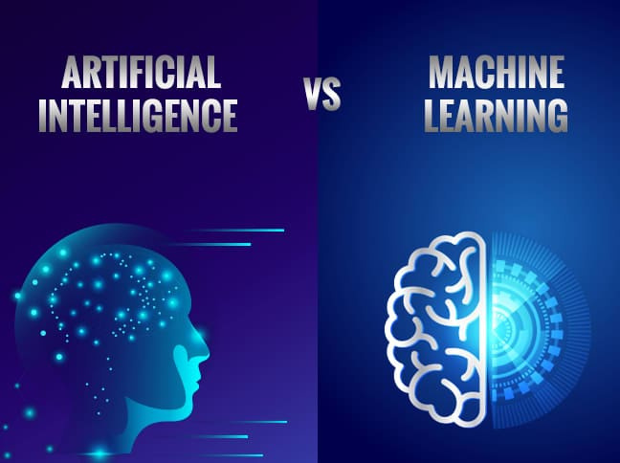
DIFFERENCE BETWEEN AI
AND
ML

Slide 9

WHAT IS NLP
Giving the machine the ABILITY to UNDERSTAND our Language as HUMANS

Slide 10
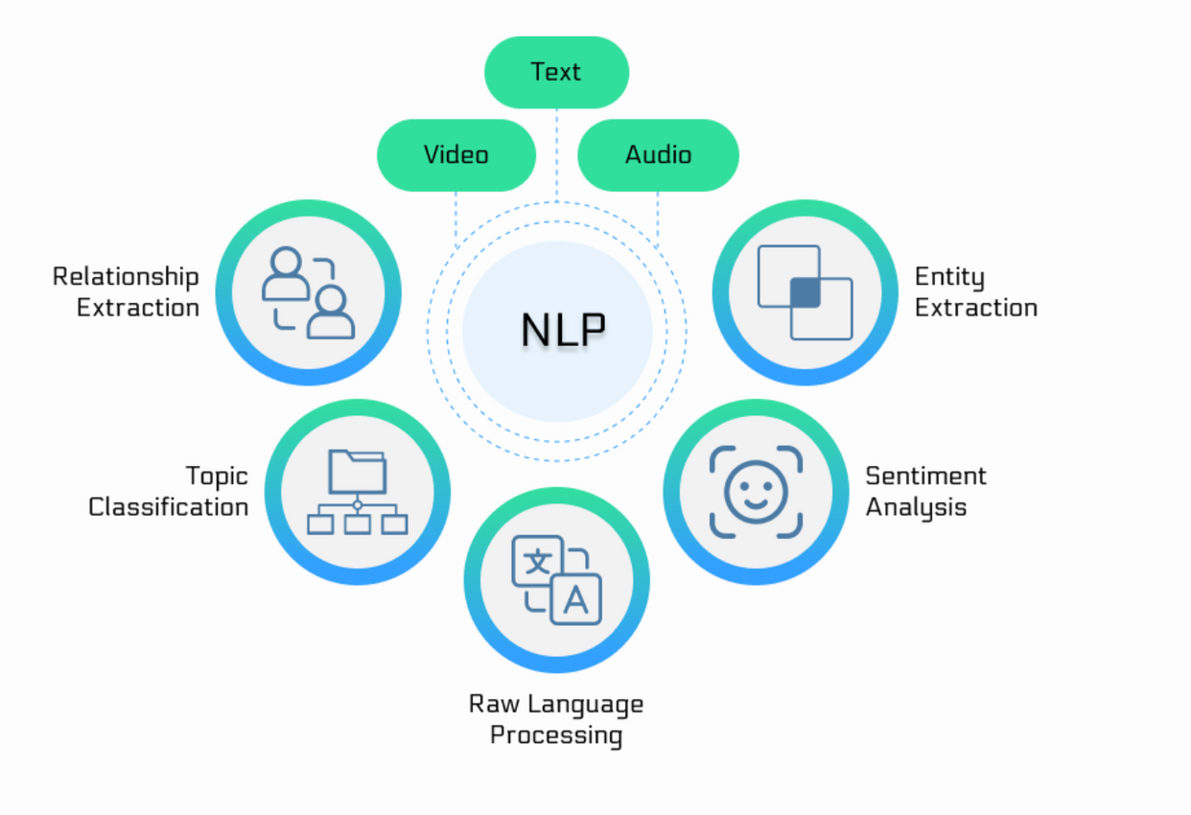
NLP APPLICATIONS

Slide 11
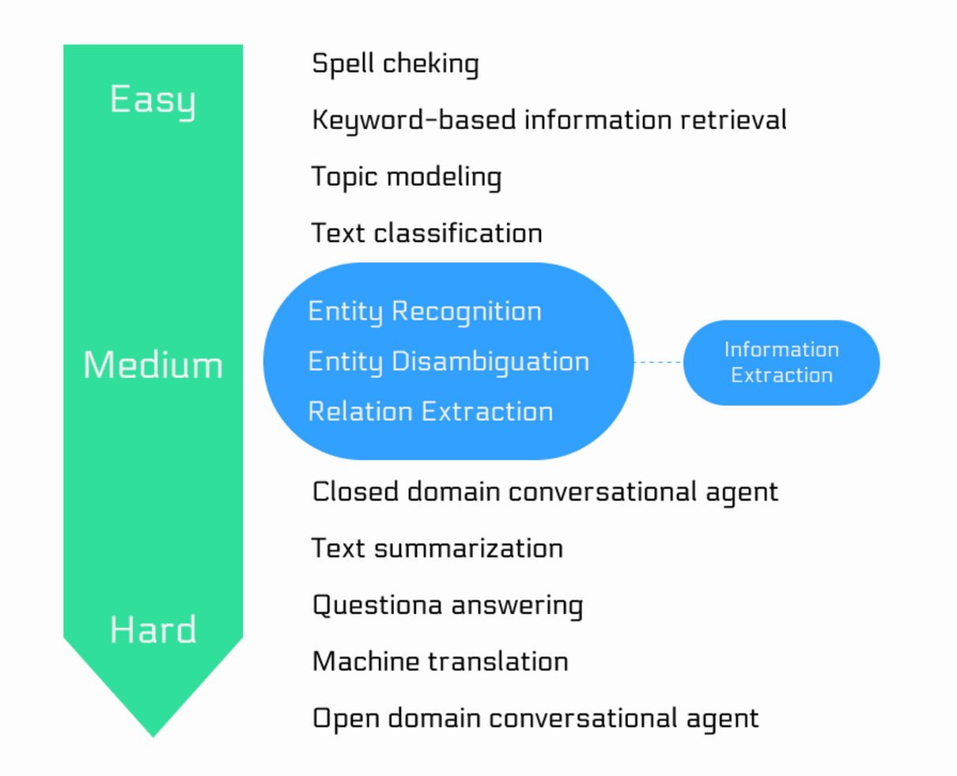
NLP APPLICATIONS

Slide 12
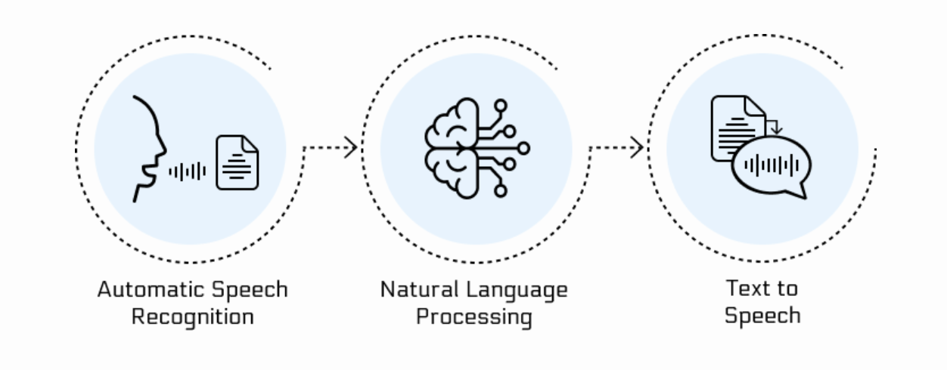
NLP APPLICATIONS -ASR
AUTOMATIC SPEECH RECOGNITION
STT

Slide 13
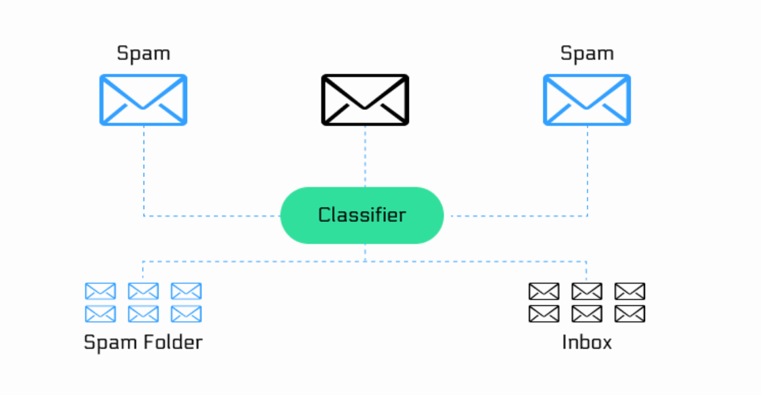
NLP APPLICATIONS -
TEXT CLASSIFICATION

Slide 14
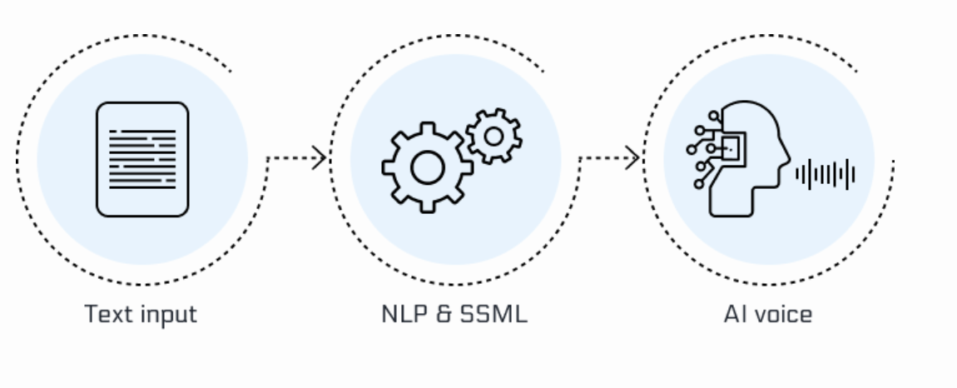
NLP APPLICATIONS -TTS
TEXT-TO-SPEECH

Slide 15
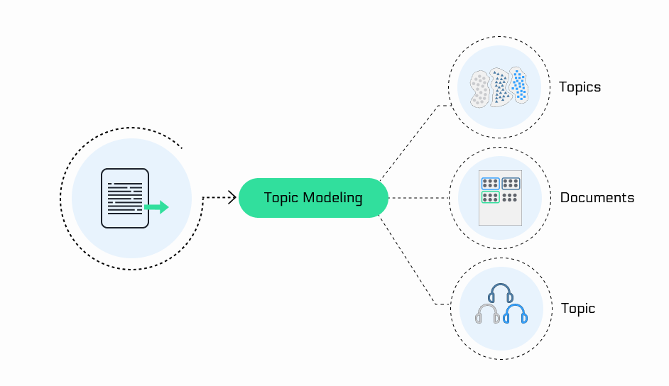
NLP APPLICATIONS -
TOPIC MODELLING

Slide 16
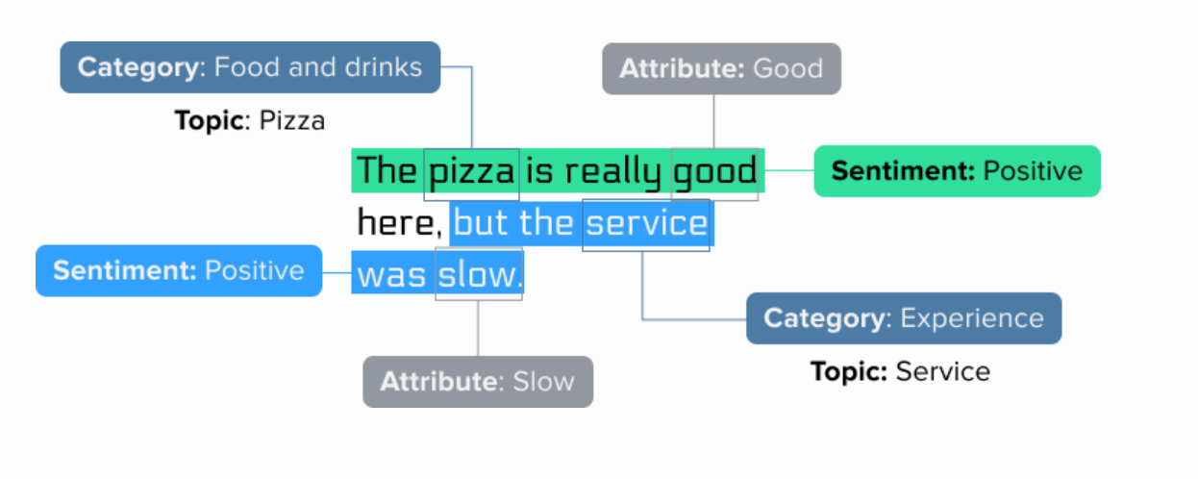
NLP APPLICATIONS -
SENTIMENT ANALYSIS

Slide 17
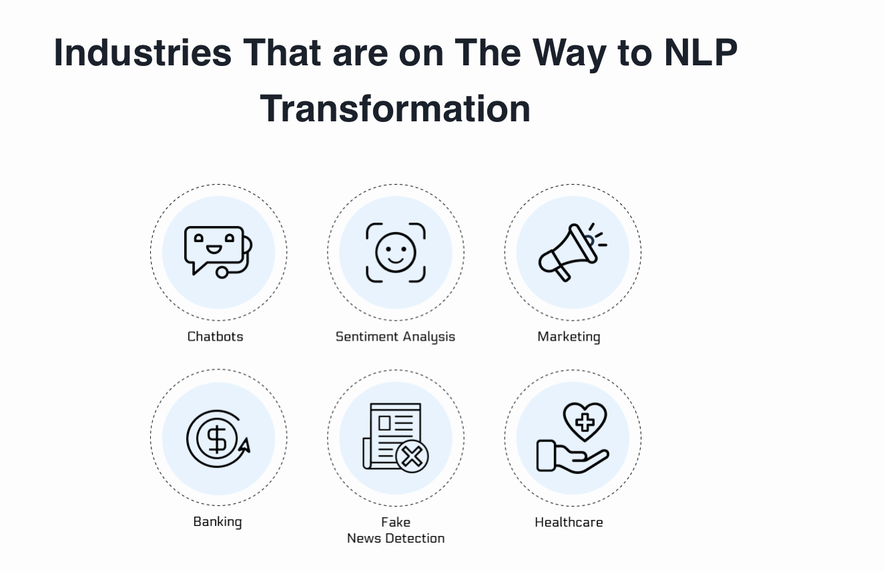

Slide 18
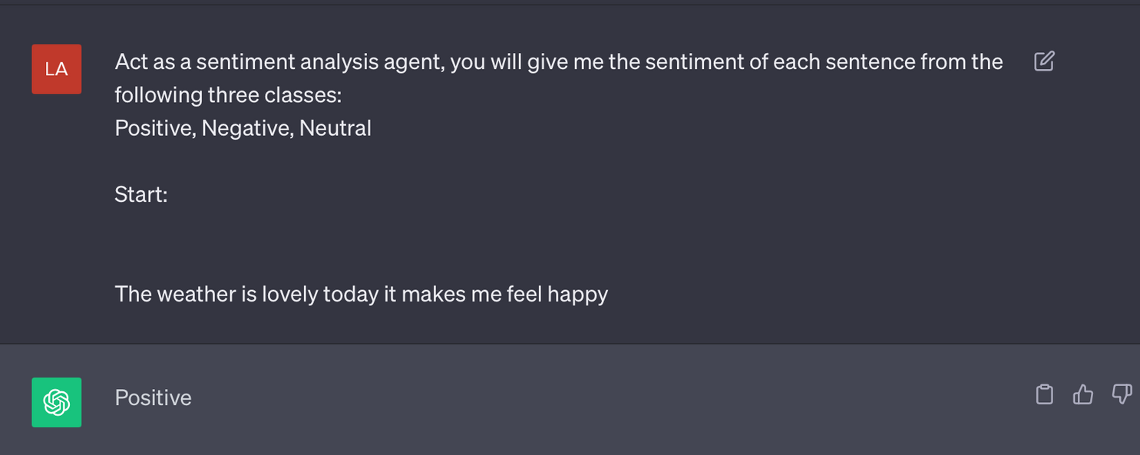
HOW CHATGPT CHANGED NLP APPLICATIONS?
Sentiment Analysis now requires one prompt, instead of hours of training!

Slide 19
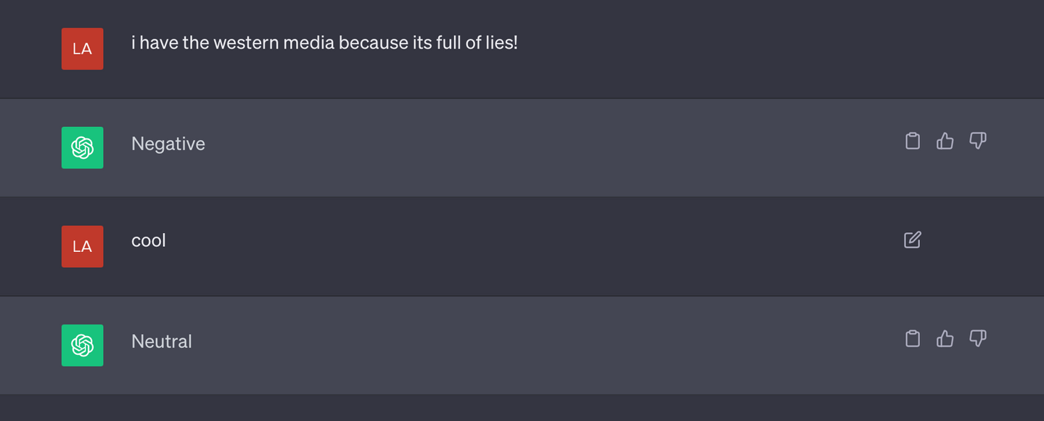
HOW CHATGPT CHANGED NLP APPLICATIONS?
Sentiment Analysis now requires one prompt, instead of hours of training!

Slide 20
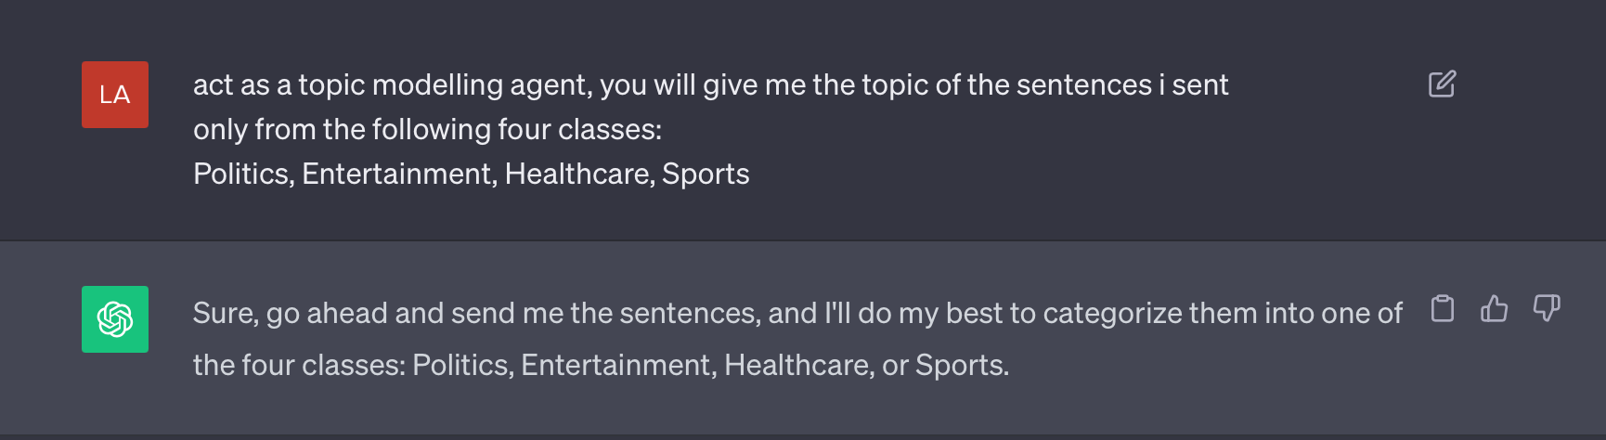
HOW CHATGPT CHANGED NLP APPLICATIONS?
2. Topic Modelling!

Slide 21
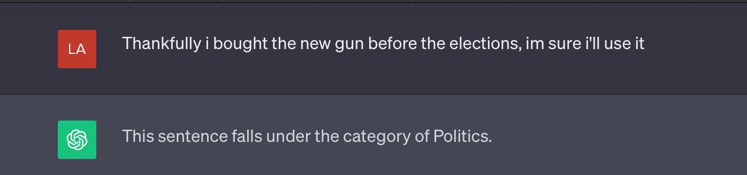
HOW CHATGPT CHANGED NLP APPLICATIONS?
2. Topic Modelling!

Slide 22
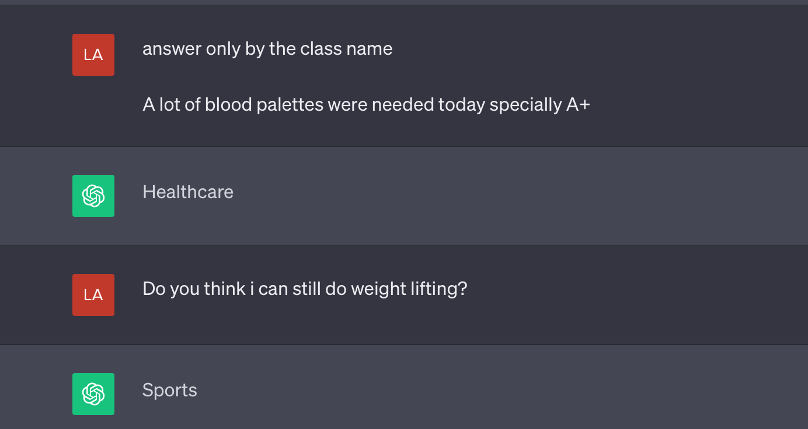
HOW CHATGPT CHANGED NLP APPLICATIONS?
2. Topic Modelling!

Slide 23
HOW DOES NLP WORK?
Tokenization: Cut words into smaller chunks
Remove stop words
Stemming: Getting the root of the word
Lemmatization: Getting the root of the word depending on the semantic meaning
Part of Speech
Choose an algorithm!

Slide 24
MAIN NLP TOOLS IN PYTHON
NLTK
HuggingFace ( NLP HUB )

Slide 25
LET’S SEE IT IN ACTION!

Slide 26
QUESTIONS TIME!

Slide 27
CLOSING CHALLENGE

